Slide 1
ALU 8-bit Simulation
Politechnica University of Timișoara, Faculty of Automation and Computer Science
Project by: Nemeș Lică, Remețan Mihnea, Tănase Alexandra, Tîrsîna Nicoleta
Coordinator teacher: Bozdog Alexandru
2’nd Semester, 2024-2025

Slide 2

Arithmetic Logic Unit
An ALU is a core component of any CPU or digital processing system. It performs arithmetic and logic operations on binary data.
In a structural implementation, the ALU is not written using behavioral code like if or case statements, but instead is built using interconnected submodules, such as adders, logic gates, and multiplexers—mimicking actual hardware design.

Slide 3
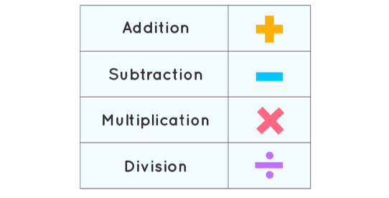
Project Overview
Purpose: simulation of a structurally designed 8-bit ALU in Verilog, integrated with 4 arithmetic operations
Notes:
Mihnea

Slide 4
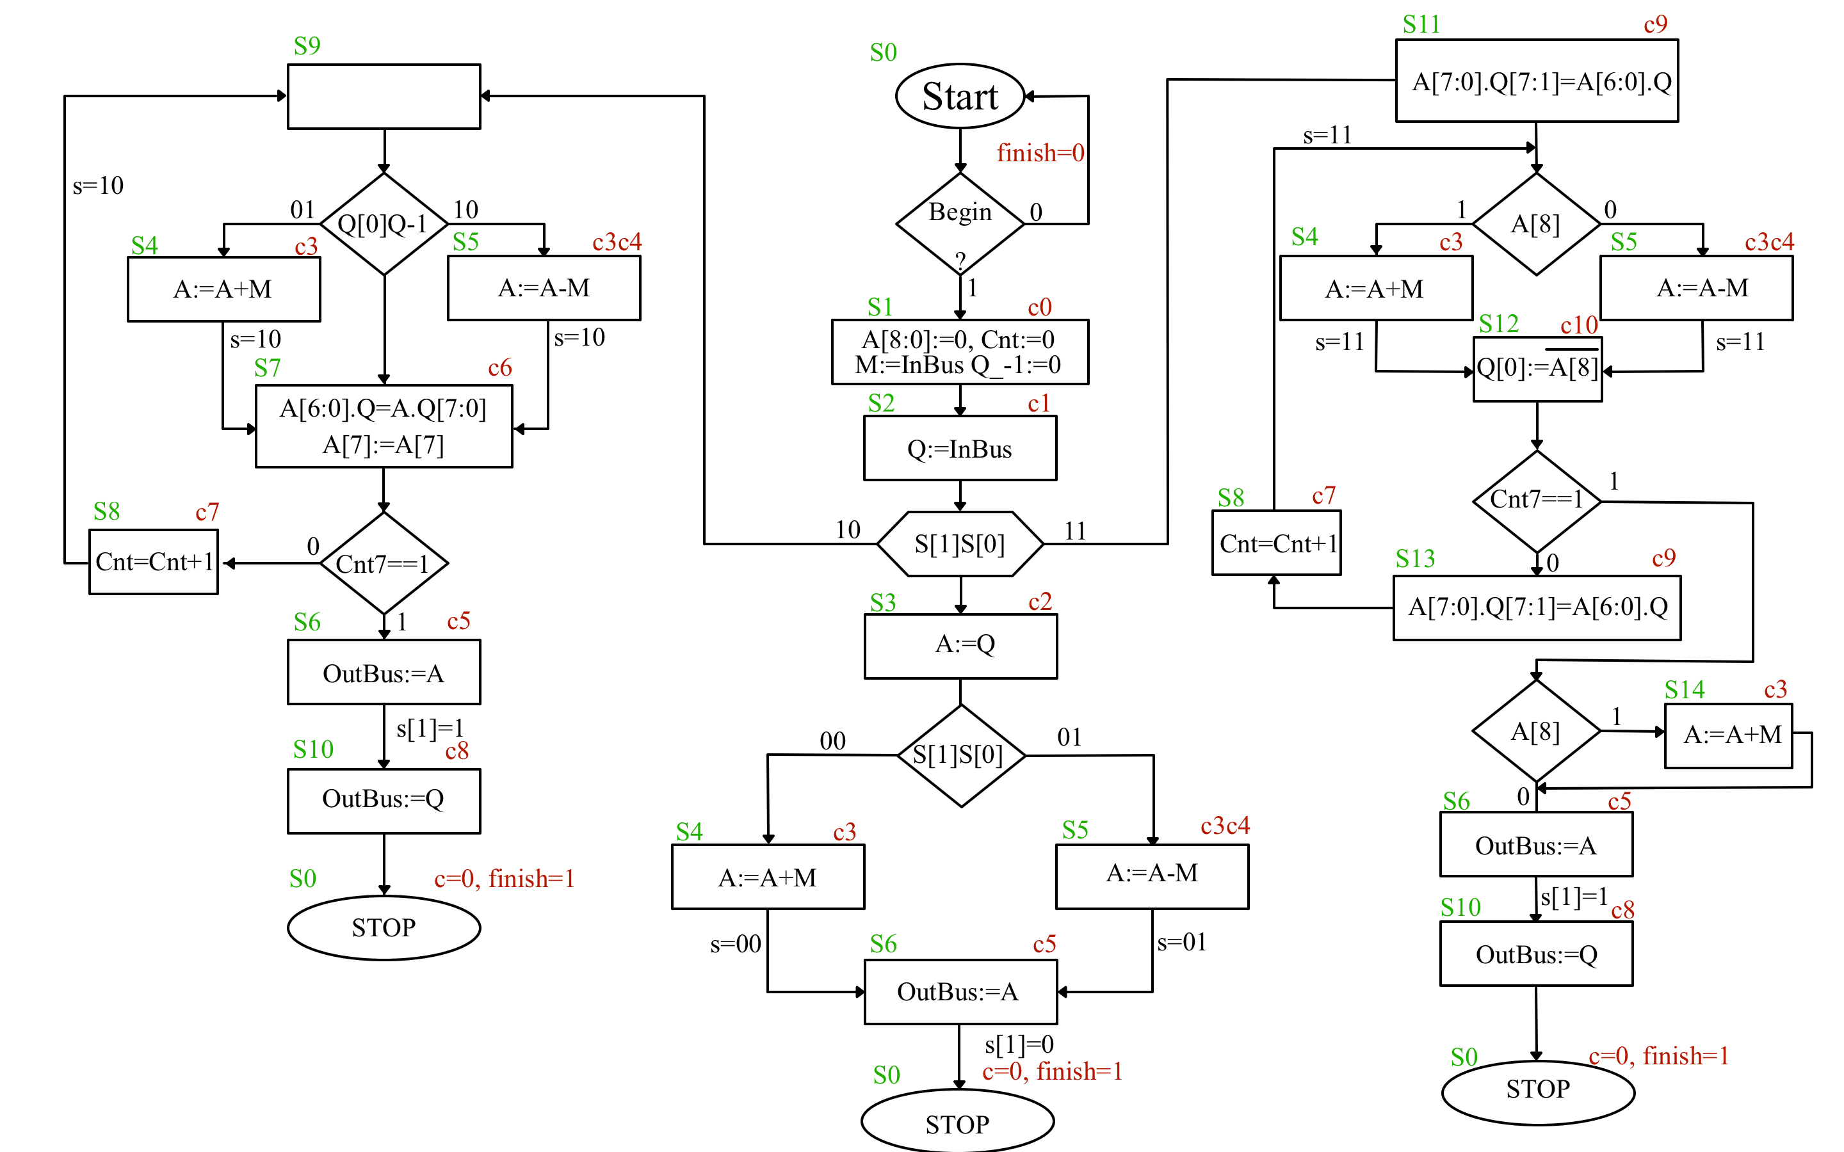
Flowchart
Notes:
Nico + Lica

Slide 5
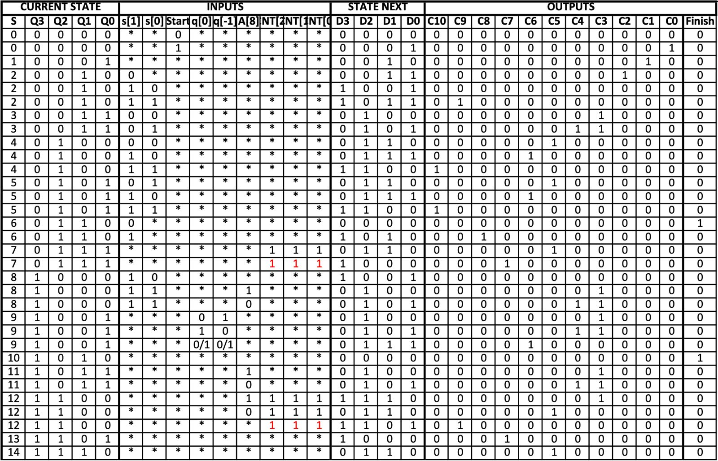
Notes:
Mihnea

Slide 6
Control Unit code
Current/Next States
ffd f3(.clk(clk),.rst_b(rst_b),.en(1'b1),
.d(
~qout[3]&~qout[2]&qout[1]&~qout[0]&s[1]&~s[0]
| ~qout[3]&~qout[2]&qout[1]&~qout[0]&s[1]&s[0]
| ~qout[3]&qout[2]&~qout[1]&~qout[0]&s[1]&s[0]
| ~qout[3]&qout[2]&~qout[1]&qout[0]&s[1]&s[0]
| ~qout[3]&qout[2]&qout[1]&~qout[0]&s[1]
| ~qout[3]&qout[2]&qout[1]&qout[0]&~(cnt[2]&cnt[1]&cnt[0])
| qout[3]&~qout[2]&~qout[1]&~qout[0]&s[1]&~s[0]
| qout[3]&qout[2]&~qout[1]&~qout[0]&a_8&cnt[2]&cnt[1]&cnt[0]
| qout[3]&qout[2]&~qout[1]&~qout[0]&~(cnt[2]&cnt[1]&cnt[0])
| qout[3]&qout[2]&~qout[1]&qout[0]
),
.q(qout[3]));
Signals
assign c[2] =~qout[3] &~qout[2] &qout[1] &~qout[0] &~s[1];
assign c[1]= ~qout[3]&~qout[2]&~qout[1]&qout[0];
assign c[0] = ~qout[3] &~qout[2]&~qout[1]&~qout[0]&start;
Notes:
Mihnea +Lica

Slide 7
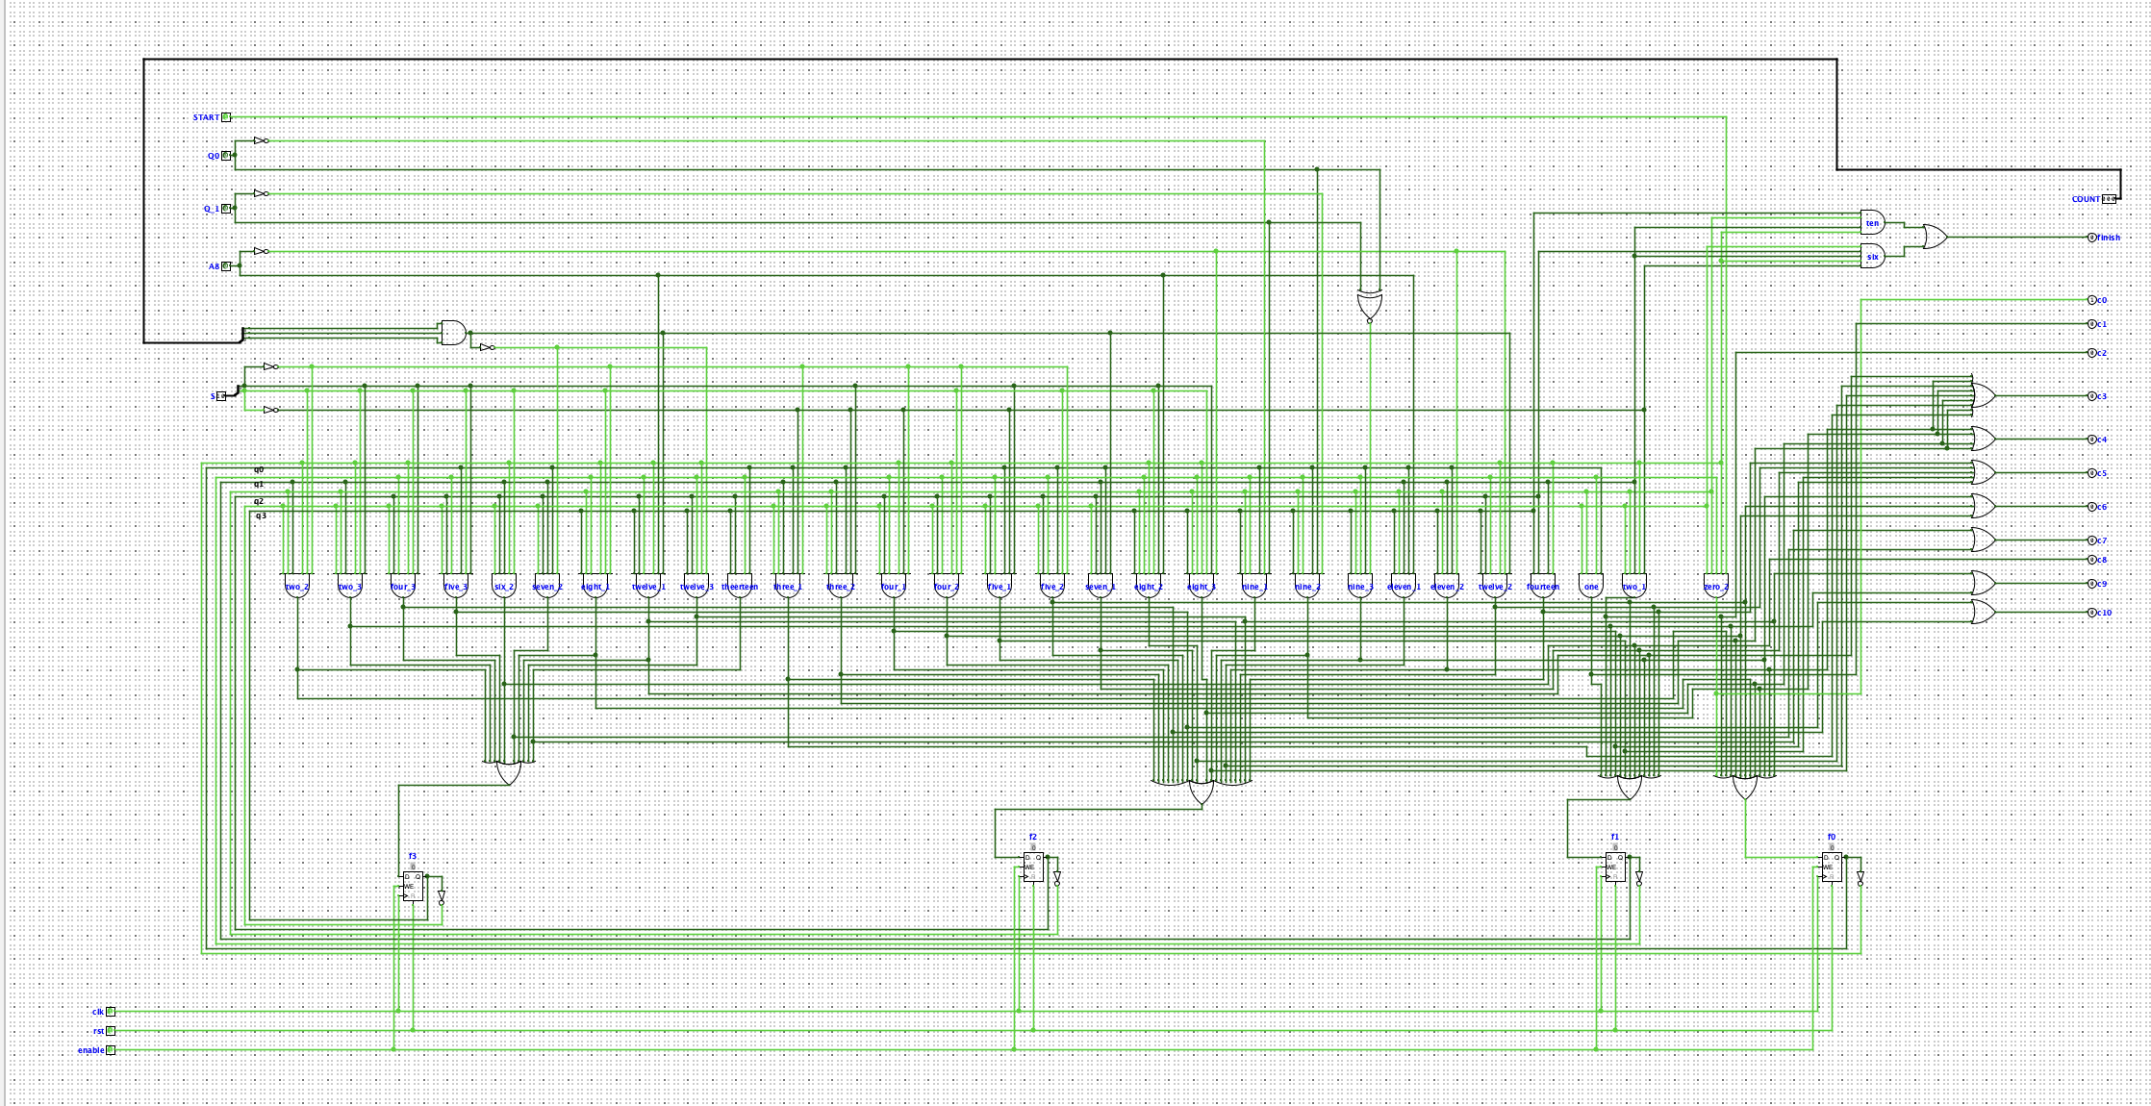
Control Unit
Notes:
Nico + Ale

Slide 8
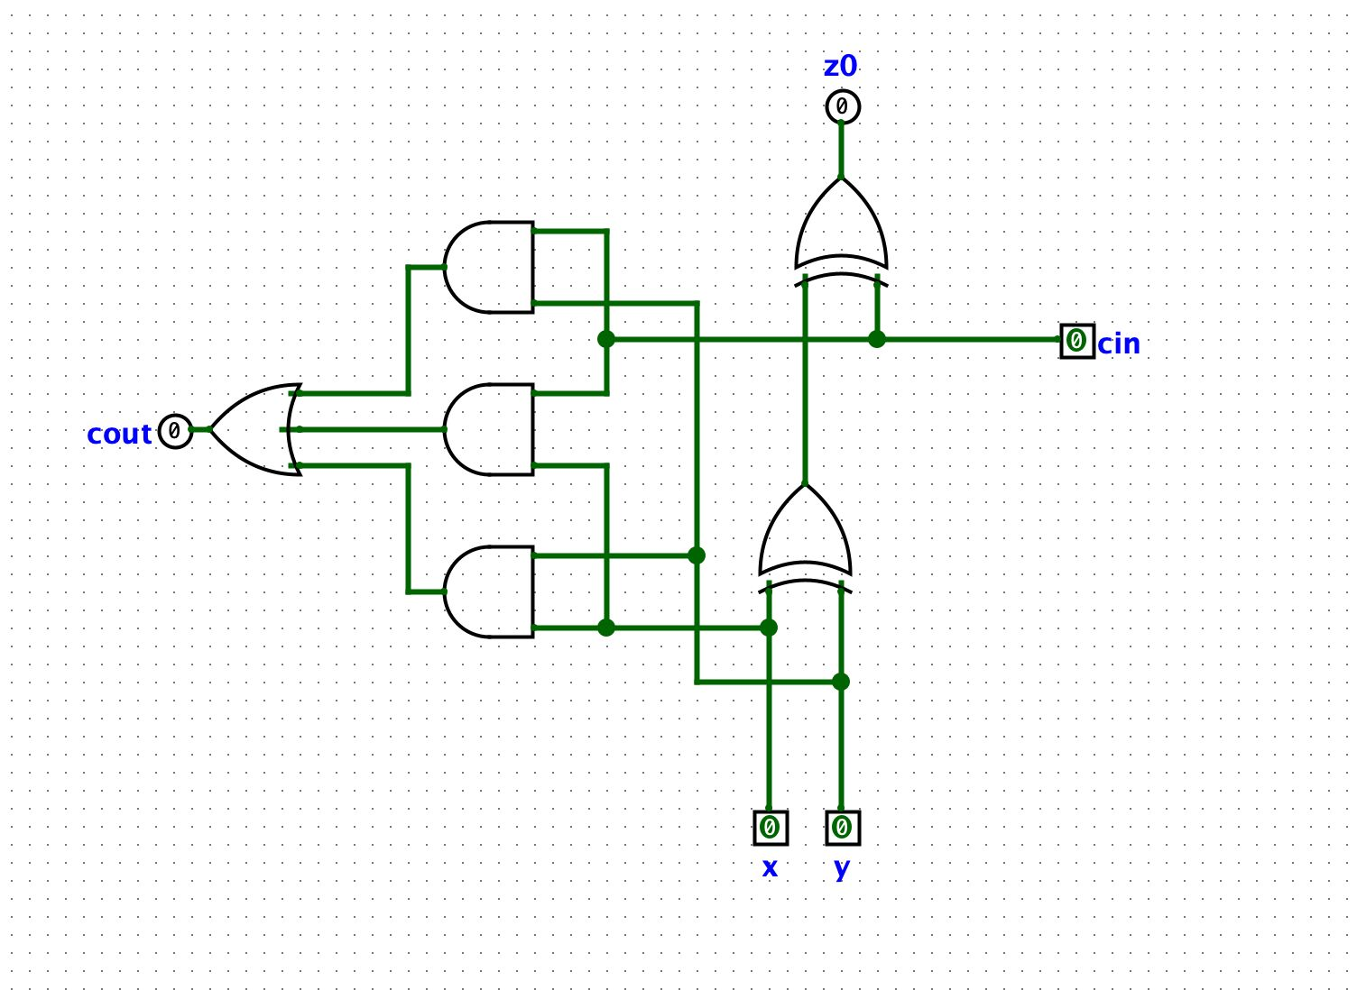
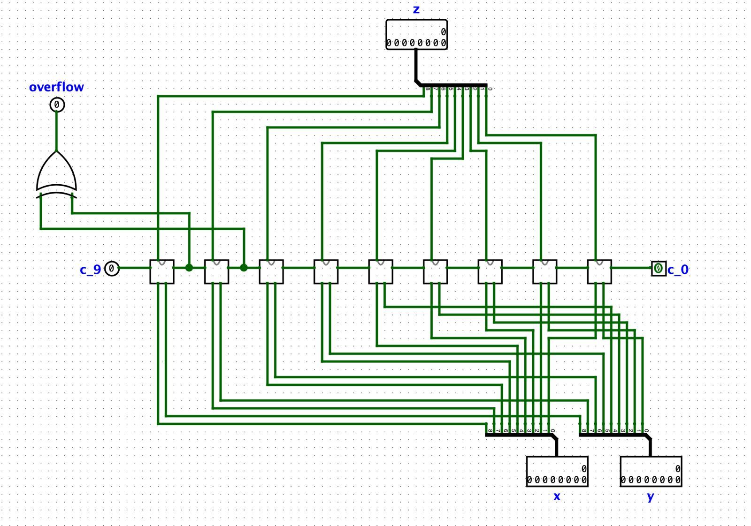
Adder
FAC
module fac(
input x,y,ci,
output z,co
);
assign z=x^y^ci;
assign co=(x&y)|(x&ci)|(y&ci);
endmodule
Notes:
Mihnea

Slide 9
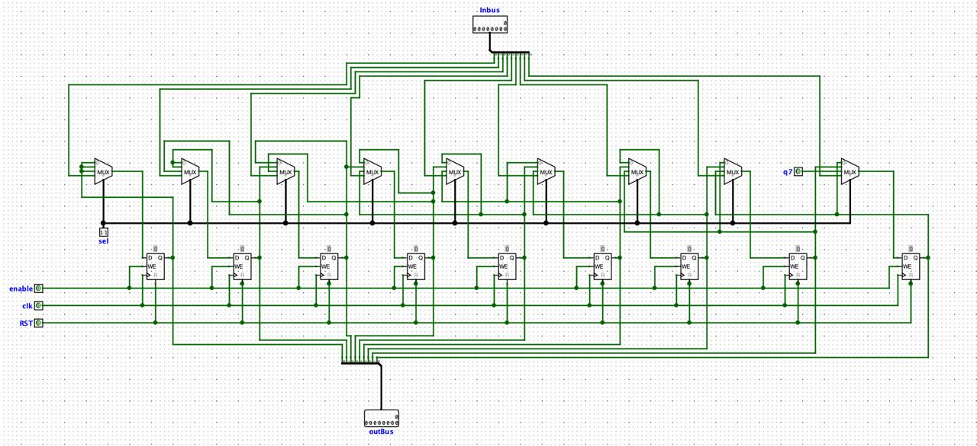
A Register
Notes:
Ale

Slide 10
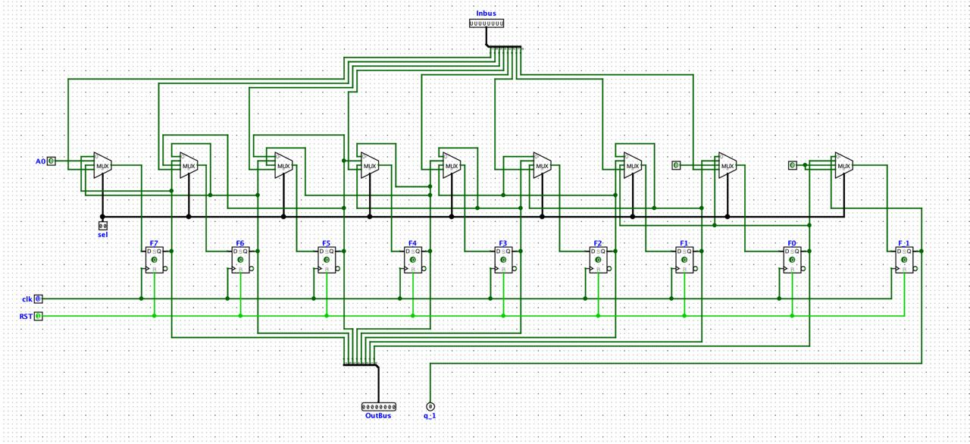
Q Register
Notes:
Ale

Slide 11
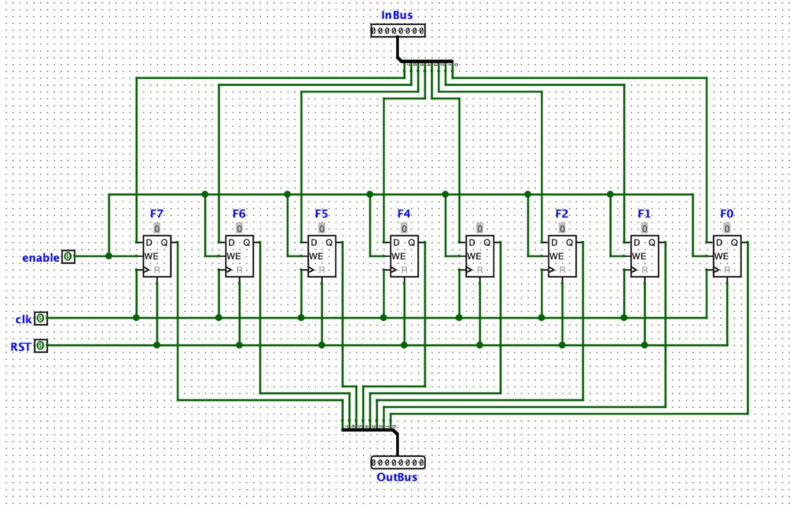
M Register
Notes:
Ale

Slide 12
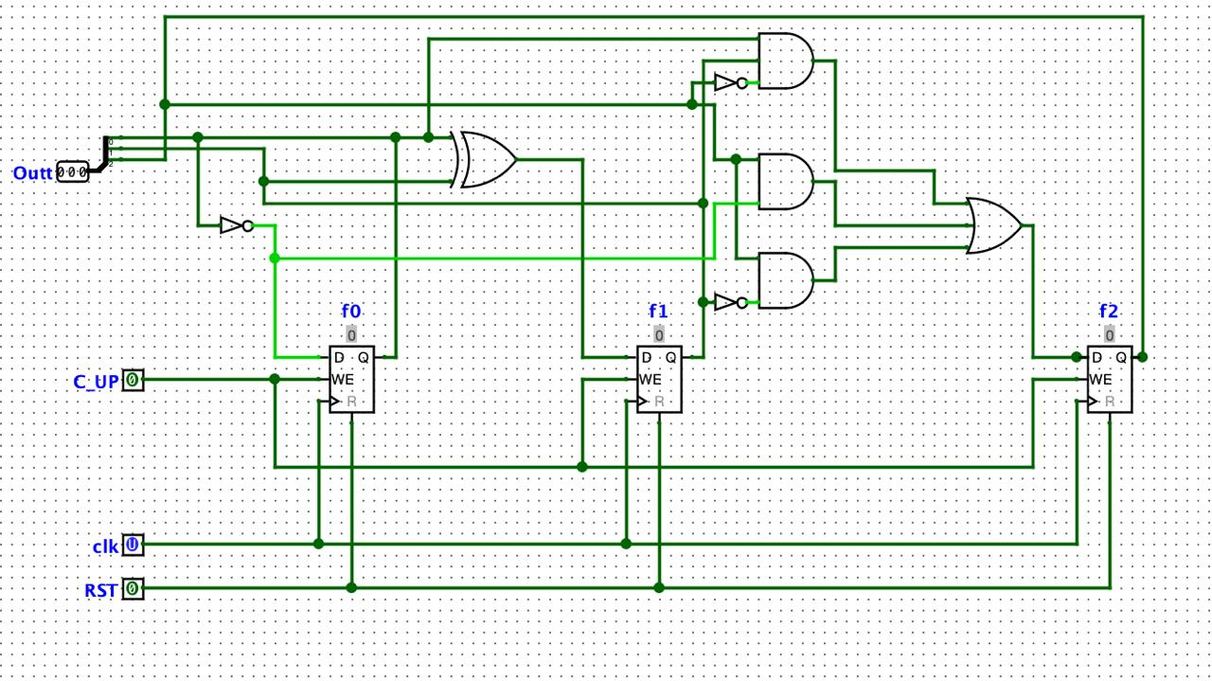
Counter
Notes:
Nico

Slide 13
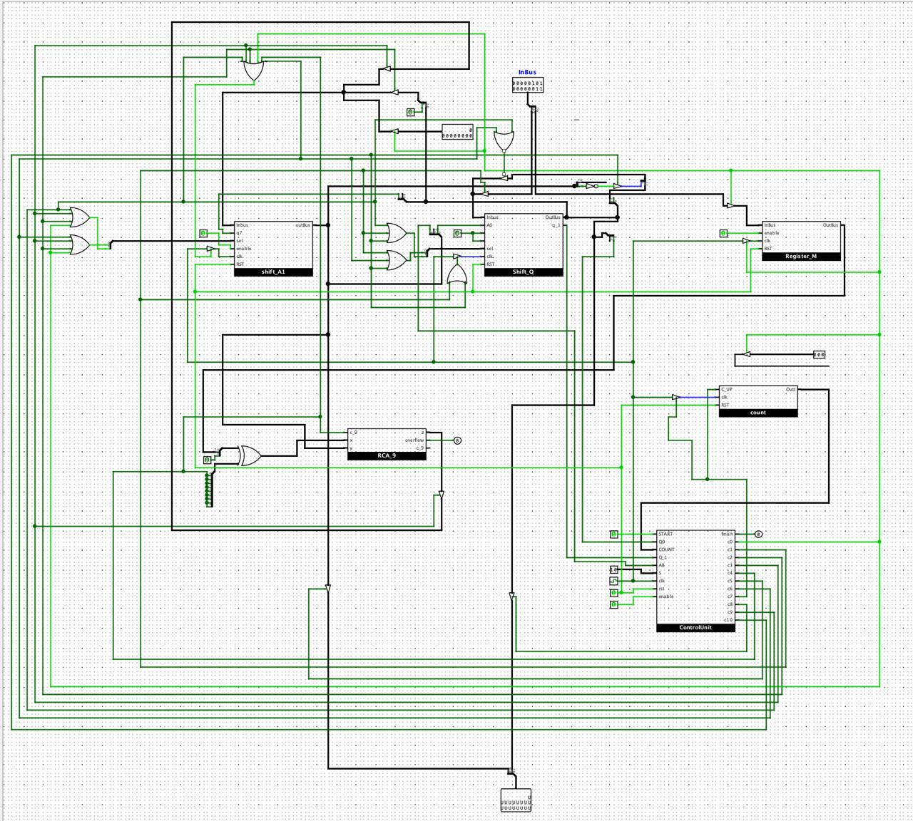
ALU
A regA
(.clk(clk),.rst_b(rst_b),.q7(q_out[7]),.sel( {c[0]|c[2]|c[3]|c[9], c[0]|c[2]|c[3]|c[6]}),.in({9{c[0]}}&9'd0 | {9{c[2]}}&q_out | {9{c[3]}}&z),.out(a_out));
Q regQ
(.clk(clk),.rst_b(rst_b),.a0(a_out[0]),.sel( {c[1]|c[9]|c[10] , c[1]|c[6]|c[10]} ),.in({8{c[1]}}&inbus | {q_out[7:1], (~a_out[8])}&{8{c[10]}} ),.out(q_out),.q_1(q_1out));
RCA adder
(.x({1'b0,m_out} ^ {9{c[4]}}),.y(a_out),.ci(c[4]),.z(z),.co(), .overflow(overfl));
Counter COUNT (.clk(clk),.rst_b(rst_b),.c_up(c[7]),.out(cnt_out));
Control_Unit CU (.clk(clk),.rst_b(rst_b),.s(s),.start(start),.q0(q_out[0]),.q_1(q_1out),.a_8(a_out[8]),.cnt(cnt_out),.c(c),.finish(finish));
assign outbus={1'b0,{8{c[5]}}}&a_out | {{8{c[8]}}}&q_out;
assign overflow=overfl & ~s[1] & c[3];
Notes:
Lica + Nico + Mihnea + Ale

Slide 14
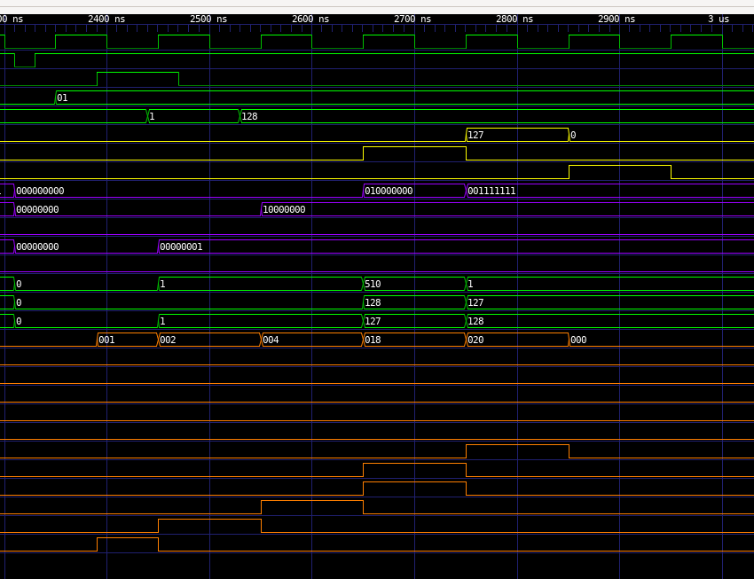
Subtracter with Overflow
Notes:
Lica

Slide 15
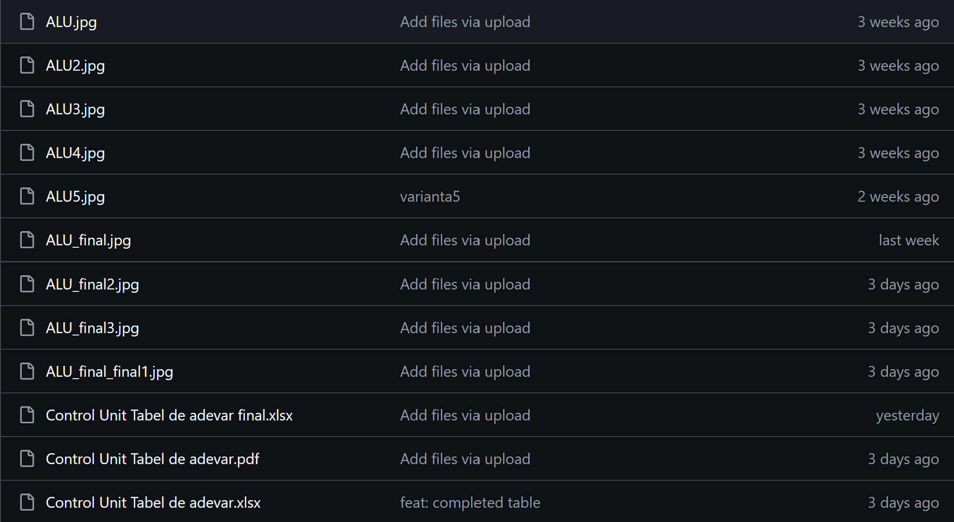
Fails :)
Notes:
+ probleme intampinate pe parcurs

Slide 16

Conclusion
This project successfully built and simulated a modular 8-bit ALU capable of performing key arithmetic operations. The use of structural Verilog and Logisim gave a dual-layered insight—both visual and code-based—into hardware design.
Notes:
Mihnea

Slide 17

Thank you for your time!
Notes:
Mihnea (+conclusion)

